Slide 1


The cia hive component
Network security – università della Calabria
project By Giada Gabriele and Michele morello

Slide 2
The cia hive component
April 14th 2017, WikiLeaks publishes six documents from the CIA's HIVE project created by its "Embedded Development Branch" (EDB). HIVE is a multi-platform CIA malware suite and its associated control software. The project provides customizable implants for Windows, Solaris, MikroTik (used in internet routers), Linux platforms and a Listening Post/Command and Control infrastructure to communicate with these implants.

Slide 3
The cia hive component
Hive can serve multiple operations using multiple implants on target computers. Each operation anonymously registers at least one cover domain for its own use. The server running the domain website is rented from commercial hosting providers as a VPS and its software is customized according to CIA specifications. These servers are the public-facing side of the CIA back-end infrastructure and act as a relay for HTTPS traffic over a VPN connection to a "hidden" CIA server called 'Blot'.

Slide 4
The cia hive component
The cover domain delivers 'innocent' content if somebody browses it by chance. A visitor will not suspect that it is anything else but a normal website. The only peculiarity is not visible to non-technical users: a HTTPS server option that is not widely used - Optional Client Authentication. Hive uses it so that the user browsing the website is not required to authenticate but implants talking to Hive do authenticate themselves and can therefore be detected by the Blot server.

Slide 5
The cia hive component
Traffic from implants is sent to an implant operator management gateway called Honeycomb while all other traffic go to a cover server that delivers the insuspicious content for all other users. The Honeycomb toolserver receives exfiltrated information from the implant; an operator can also task the implant to execute jobs on the target computer, so the toolserver acts as a command and control server for the implant.

Slide 6
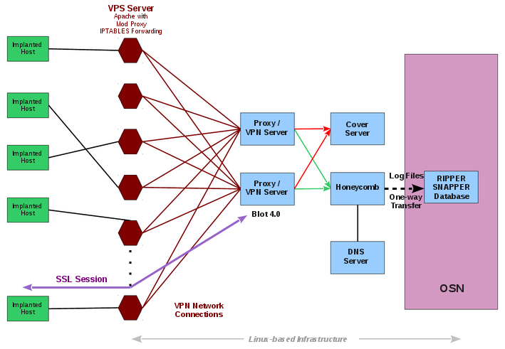
The cia hive component
source: https://wikileaks.org/vault8/#Hive

Slide 7
The cia hive component – technical aspects

Slide 8
The cia hive component – technical aspects
Hive has two main functions: beacons and interactive shells; by design both are limited in functionality because they are basically just a base for other tools. In version 2.9 an internal DNS server is added to enable name resolution in MikroTik 6.x, the possibility for the user to define the directory path for .config .log files and adds AVTech Network Video Recorders to the list of supported platforms.

Slide 9
The cia hive component – technical aspects
The implant communicates with the Hive client using SSL connections. Three files, server.crt, server.key and ca.crt, must be installed in the same directory as the client and must have read permissions set so they can be accessed by the client. Communications with the implant will fail if any one of these files are missing or invalid.

Slide 10
The cia hive component – technical aspects
Before the initial distribution the Blot must be configured with the Hive id (0x65ae82c7) for proxy connections to the Honeycomb manager, the latter can reside on the same Blot server, but it is recommended to distribute it on a different one. Honeycomb behaves like a normal server which handles incoming beacon connections one-by-one, after the plant is configured by Blot all traffic is redirected directly to Honeycomb which establishes an encrypted session and Blot continues to proxy the encrypted network packets.

Slide 11
The cia hive component – technical aspects
The Hive project did not make any changes to the binaries or the Blot server, it aims to conform to existing protocols and procedures. In the Blot configuration files the most important parameters are IP, the port for the tool manager such as Honeycomb and the Hive Tool ID. Upon receiving a signal, Honeycomb will analyze MAC address, IP and the time of activity, will then write a .rsi file that will be sent unidirectionally for ingestion into the Ripper Snapper.

Slide 12
The cia hive component – technical aspects
Hive v2.0 functionality has been added to Honeycomb to keep a basic log of beacons received. Each beacon will have a log entry created that contains a timestamp of when the beacon was received, the MAC address, the public IP address, and the version of the plant that received the beacon. Also, for Hive v2.0 and later beacons, there will be a flag related to the operating system from which the beacon comes.

Slide 13
The cia hive component – demo

